Slide 1
18W QC3.0_(5V/3A,9V/2A,12V/1.5A)
AP3302_APR34509_AP43331
QQ: 2351983636
AE JF Liu
2016.9.19

Slide 2
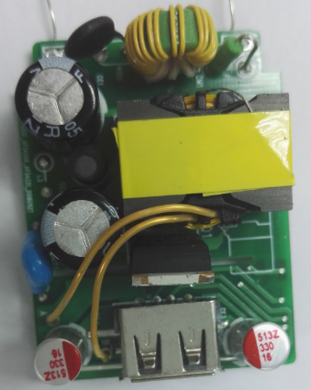
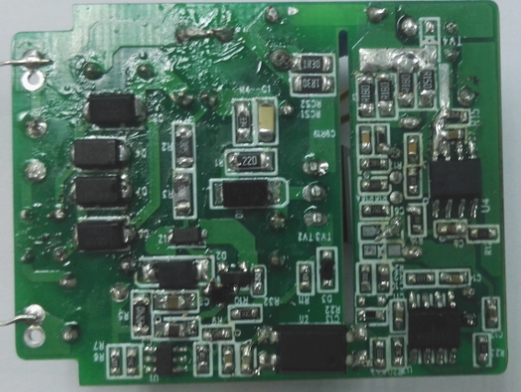
Demo Board Photo

Slide 3
Schematic

Slide 4
BOM List
Item | Type | Item | Type
CE1, CE2 | 15uF/400V,AL CAP | R32 | 10K,0603
CE3,CE4 | 330uF/16V,solid cap | R5 | 2.4ohm,0805
CY1 | 220pf,Y1 Cap | R21 | 0 ohm,0603
C2 | 2.2uF/50V,0805, ceramic | Rcs3 Rcs4 Rcs5 | 0.18R 0805 ,1%
C3 | 10uF/50V,0805, ceramic | Rcs6 | 0.15R 0805 ,1%
C5 | 2.2nF, 16V, 0603,ceramic | Rcs1 Rcs2 | 1.3R 1206
C6 | 1nF,100V 0603,ceramic | R20 | 56K,0603
C12,C8 | 100nF,16V 0603,ceramic | R24 | 4.7K,0603
C7 | 10nF,16V 0603,ceramic | R15 | 51.1K,0603 ,1%
C10 | 100pF, 16V, 0603,ceramic | R22 | 1K,0603
C4 | 470pF, 16V, 0603,ceramic | R12,R16,R23 | 20 ohm 0603
C1 | 1nF/500V,0805, ceramic | R17 | 39K,0603 ,1%
C11 | 56nF, 16V, 0603,ceramic | R18 | 4.7K,0603,1%
C14 | 5.6nF/16V,0805, ceramic | R18A | 56K,0603,1%
C9 | 1nF,16V 0603,ceramic | R13 | 20 ohm 0603
C13 | NC | R25 | 4.7K,0603
C 15 | 1nF 250V 0805 | R11 | 200ohm 0603
D4,D5,D6,D7 | S2MA SMA | R10 | 10ohm 0603
D1 | S1M SMA | R9 | 47k 0603
D2 | RS1M SMA | R8 | 560ohm,0805
D3 D8 | BAV21WS | R6 | 300K, 0603,1%
U1 | AP3302 | R7 | 33K,0603,1%
U2 | L1332 816C | R19 | 1K,0603
U5 | AP43331 | F1 | 2A 250V
U4 | AP34509 | NTC1 | NTC 5D-7
Q1 | ST8N65 | CM1 | 1.5mH
R19 | 1K,0603 | L1 | 220uH
R2, R3 | 3M,1206 | TVS2/TVS3 | D5V0L1
R1 | 22ohm,1206 | TVS4 | CD-T15SC
R4 | 330K,0805 | T1 | PQ2016
Q3 | MMBT3904 | Z1 | 24V SMD zenner
 |  | L2 | 3.3uH 0805

Slide 5
Transformer Specification
PQ2016 (AE=64mm^2)
NO | NAME | TERMINAL NO. |  | WINDING
 |  | START | FINISH | WIRE | TURNS | ORIENTATION
1 | Np1 (2/3) | 5 | 3 | 0.23Φ*1 | 37.5 | P
2 | Vcc | 1 | 2 | 0.18*1 | 15 | P
3 | SEC | A | B | 0.7Φ TIW *1 | 5 | P
4 | Shield | 2 | NC | 0.13*1 | 29 | P
5 | Np1 (1/3) | 3 | 6 | 0.23 | 17.5 | P
The core connect to the Pin2 (primary side GND）
Primary Inductance | Pin 5-4,all other windings open, measured at 1kHz, 0.4VRMS | 0.9mH, ±7%
Primary Leakage Inductance | Pin 5-4, all other windings shorted, measured at 10kHz, 0.4VRMS | 30 uH (Max.)

Slide 6
Standby Power
Output Voltage | Input Voltage | Standby Power (mW)
5V | 85 | 31
 | 115 | 33
 | 230 | 48
 | 264 | 62

Slide 7
Power Conversion Efficiency（PCB end)
 | 115V 60Hz |  |  | 230V 50Hz |  | 6级能效
 | Iout | effici | average | effici | average | >81.39%
5V | 3 | 86.75% | 87.74% | 87.96% | 88.18%
 | 2.25 | 87.75% |  | 88.24%
 | 1.5 | 88.34% |  | 88.36%
 | 0.75 | 88.12% |  | 88.16%
 | 0.3 | 86.42% |  | 85.44%
 | 115V 60Hz |  |  | 230V 50Hz
 | Iout | effici | average | effici | average | >85%
9V | 2 | 88.96% | 88.66% | 90.03% | 89.07%
 | 1.5 | 89.19% |  | 89.91%
 | 1 | 88.94% |  | 89.31%
 | 0.5 | 87.54% |  | 87.02%
 | 0.2 | 81.70% |  | 83.24%
 | 115V 60Hz |  |  | 230V 50Hz
 | Iout | effici | average | effici | average | >85%
12V | 1.5 | 88.88% | 87.74% | 90.21% | 88.40%
 | 1.125 | 88.67% |  | 89.70%
 | 0.75 | 88.15% |  | 88.60%
 | 0.375 | 85.25% |  | 85.09%
 | 0.15 | 76.91% |  | 78.29%

Slide 8
QC3.0 I--V Curve@ Board End

Slide 9
MTK2.0 I--V Curve@ Board End

Slide 10
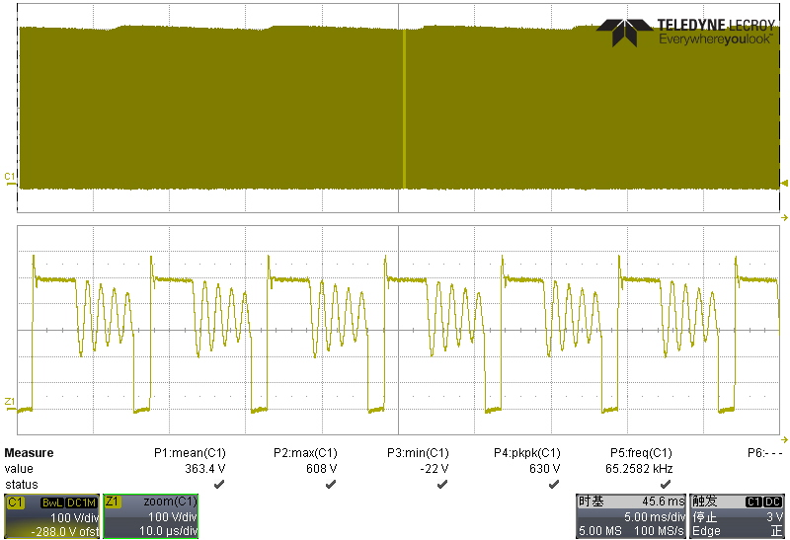
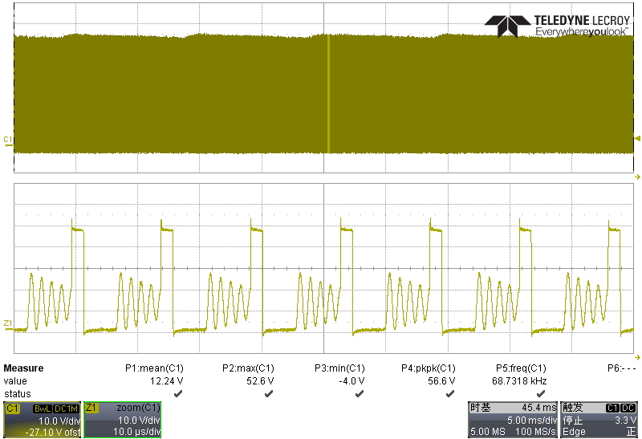
Q1 /Q2 voltage stress(T1)
Test condition
1). Vin=264V 50Hz
2). I_load=12V 1.5A
Vds_max=608Vs
Vds_max=52.6Vs

Slide 11
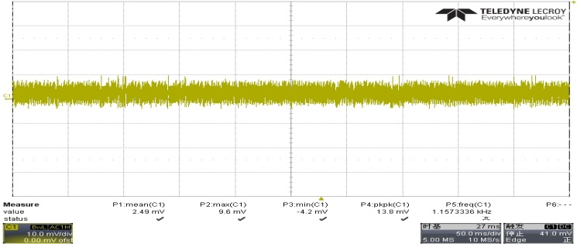
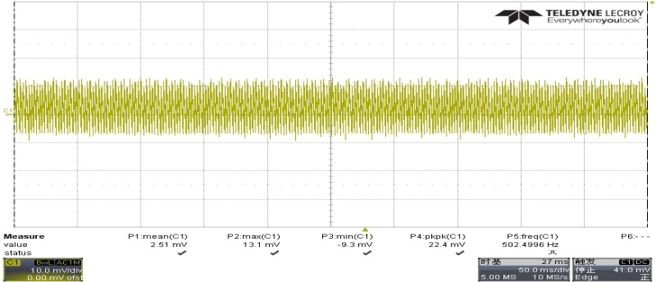
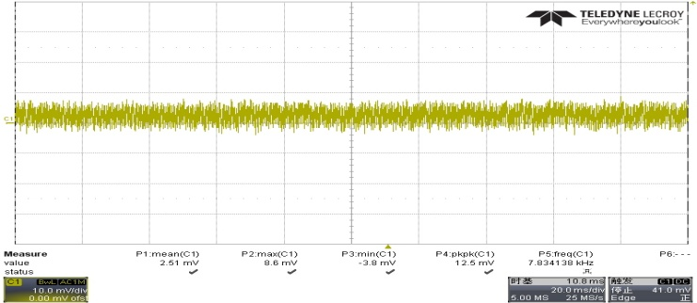
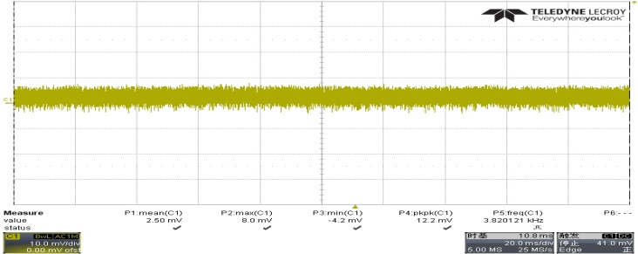
Output Ripple and Noise @ No Load demo
VIN: 90VAC | VIN: 264VAC
5V
5V
Test condition
- 20MHz Bandwidth
- Connect 4.7uF AL Cap and
104 MLCC to the cable end
9V
9V
12V
12V
Vinac (V) | 5V | 9V | 12V
90 | 13.8mV | 12.5mV | 12.2mV
264 | 22.4mV | 17.3mV | 19.2mV

Slide 12
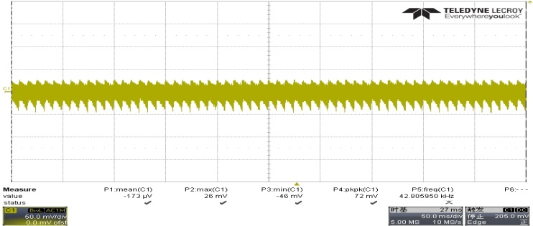
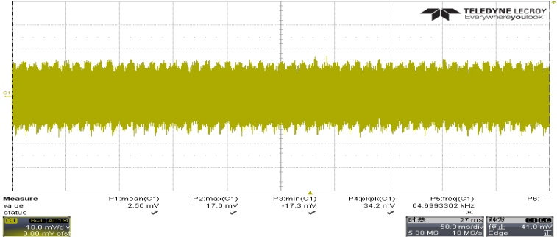
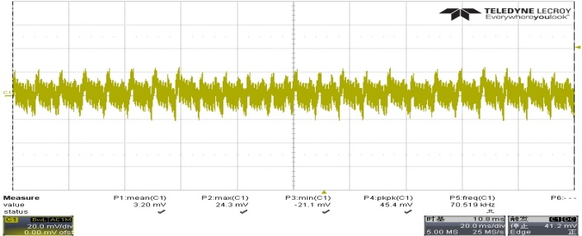
Output Ripple and Noise @ Full Load demo
VIN: 90VAC | VIN: 264VAC
5V
5V
Test condition
- 20MHz Bandwidth
- Connect 4.7uF AL Cap and
104 MLCC to the cable end
9V
9V
12V
12V
Vinac (V) | 5V | 9V | 12V
90 | 72mV | 64mV | 45.4mV
264 | 34.2mV | 37.1mV | 28.8mV

Slide 13
Load Dynamic Response @ Board End
@5V
Loading | 10ms-10ms |  | 100ms-100ms |  | 200ms-200ms
 | Vo_min | Vo_max | Vo_min | Vo_max | Vo_min | Vo_max
0-->100% | 4.81 | 5.51 | 5.04 | 5.5 | 4.99 | 5.5
0-->50% | 4.96 | 5.33 | 5.04 | 5.32 | 5.01 | 5.32
10-->90% | 4.92 | 5.43 | 4.91 | 5.44 | 4.88 | 5.42
@9V
Loading | 10ms-10ms |  | 100ms-100ms |  | 200ms-200ms
 | Vo_min | Vo_max | Vo_min | Vo_max | Vo_min | Vo_max
0-->100% | 8.85 | 9.38 | 8.97 | 9.39 | 8.95 | 9.39
0-->50% | 8.91 | 9.24 | 8.98 | 9.27 | 8.95 | 9.25
10-->90% | 8.89 | 9.35 | 8.9 | 9.33 | 8.89 | 9.32
@12V
Loading | 10ms-10ms |  | 100ms-100ms |  | 200ms-200ms
 | Vo_min | Vo_max | Vo_min | Vo_max | Vo_min | Vo_max
0-->100% | 11.77 | 12.24 | 11.9 | 12.25 | 11.88 | 12.25
0-->50% | 11.82 | 12.17 | 11.89 | 12.17 | 11.88 | 12.16
10-->90% | 11.85 | 12.21 | 11.84 | 12.23 | 11.82 | 12.2

Slide 14
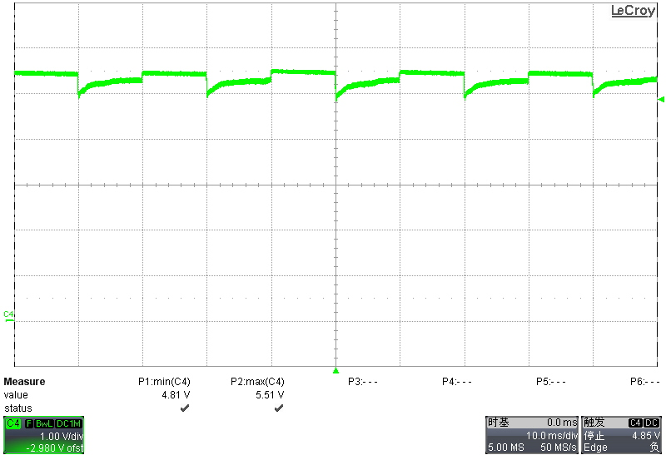
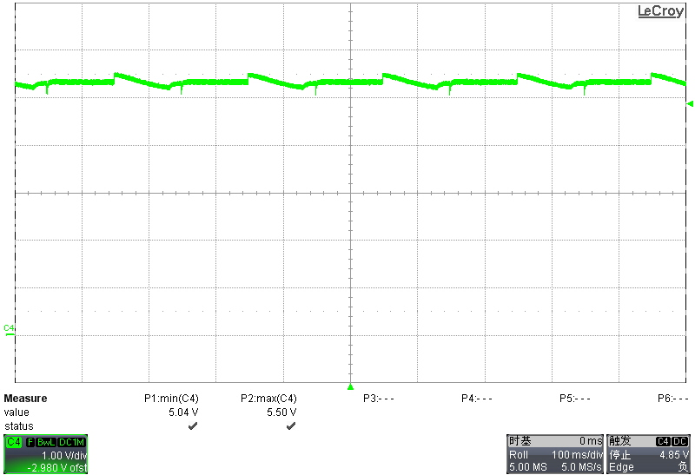
Load Dynamic Response Waveform@5V (1)
10ms—10ms
100ms—100ms
0→100%
200ms—200ms

Slide 15
Load Dynamic Response Waveform@5V (2)
10ms—10ms
100ms—100ms
0→50%
200ms—200ms

Slide 16
Load Dynamic Response Waveform@5V (3)
10ms—10ms
100ms—100ms
10→90%
200ms—200ms

Slide 17
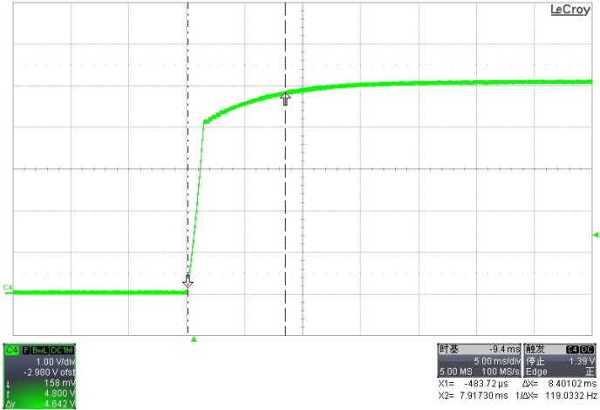
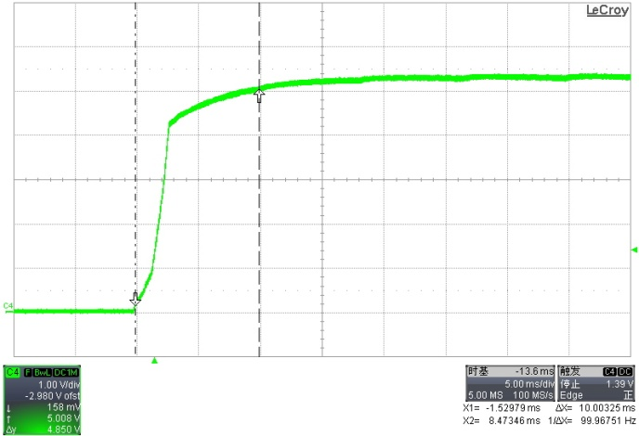
Vout Rising Time@ 5V Output
Vin_ac=85V, Iout=0A | Vin_ac=265V, Iout=0A
Vin_ac=85V, Iout=3.0A | Vin_ac=265V, Iout=3.0A
Test condition
- Measure output voltage rising time at 85Vac/60Hz and 264Vac/50Hz ( 0V to 4.75V)
- Load: CC mode
Vac(V) | 85 |  | 265
Iout(A) | 0 | 3.0 | 0 | 3.0
Trising (mS) | 8.40 | 10 | 8.09 | 9.73

Slide 18
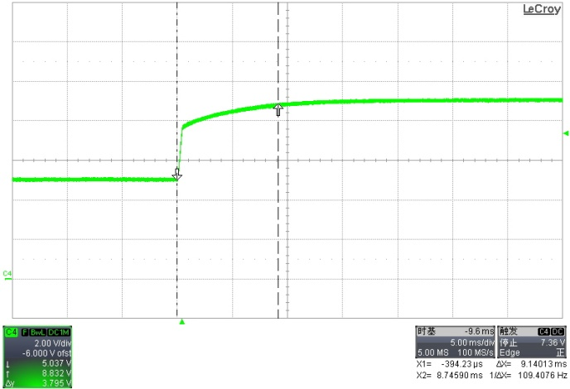
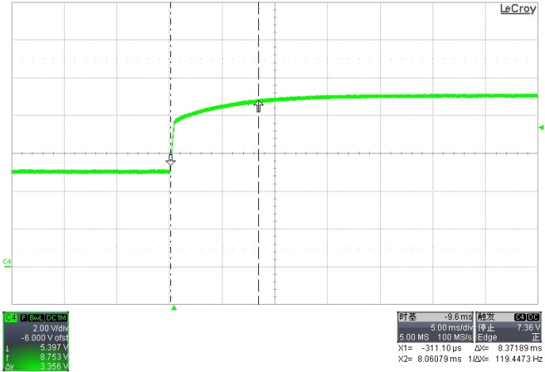
5V→9V Transition Time
5V→9V @ 85V, 0A | 5V→9V @ 265 V, 0A
5V→9V @ 85Vac, 2.0A | 5V→9V @ 265Vac, 2.0A
85V
Vac(V) | 85 |  | 265
Iout(A) | 0 | 2.0 | 0 | 2.0
Transition time (mS) | 9.14 | 9.68 | 8.37 | 8.43

Slide 19
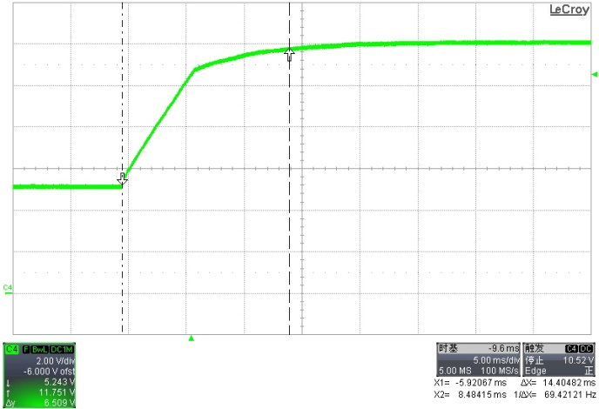
5V→12V Transition Time
5V→12V @ 85V, 0A | 5V→12V @ 265 V, 0A
5V→12V @ 85Vac, 1.5A | 5V→12V @ 265Vac, 1.5A
85V
Vac(V) | 85 |  | 265
Iout(A) | 0 | 1.5 | 0 | 1.5
Transition time (mS) | 12.77 | 14.40 | 12.79 | 14.07

Slide 20
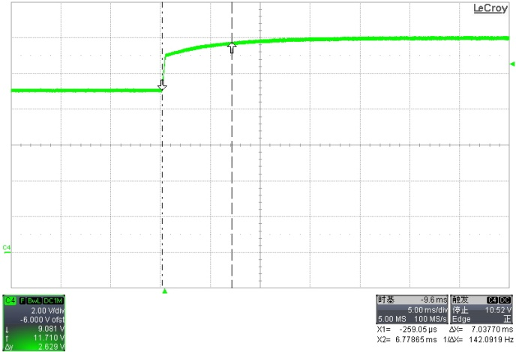
9V→12V Transition Time
9V→12V @ 85V, 0A | 9V→12V @ 265 V, 0A
9V→12V @ 85Vac, 1.5A | 9V→12V @ 265Vac, 1.5A
85V
Vac(V) | 85 |  | 265
Iout(A) | 0 | 1.5 | 0 | 1.5
Transition time (mS) | 7.03 | 8.13 | 7 | 7.78

Slide 21
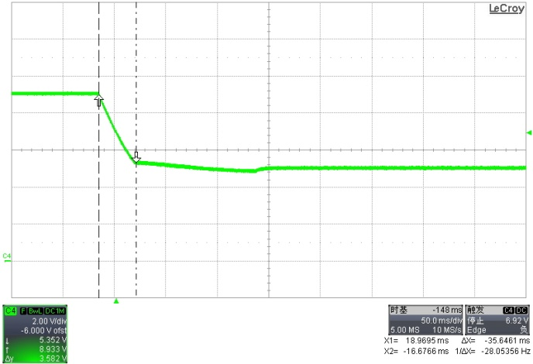
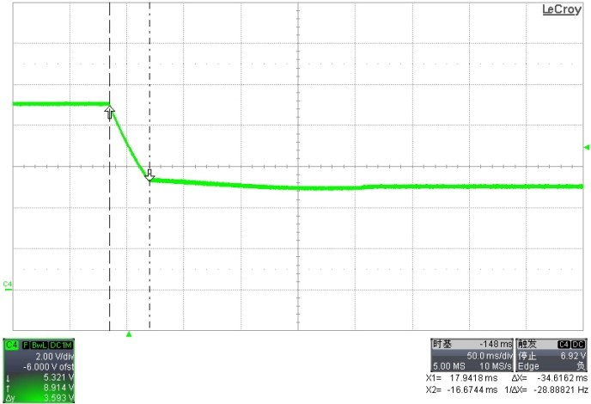
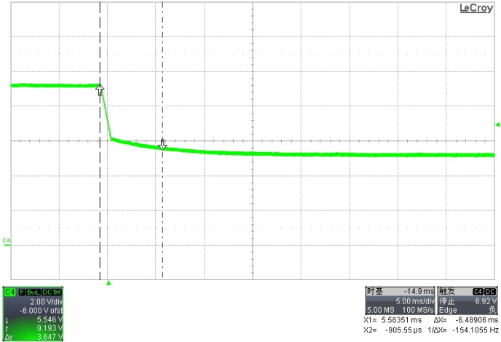
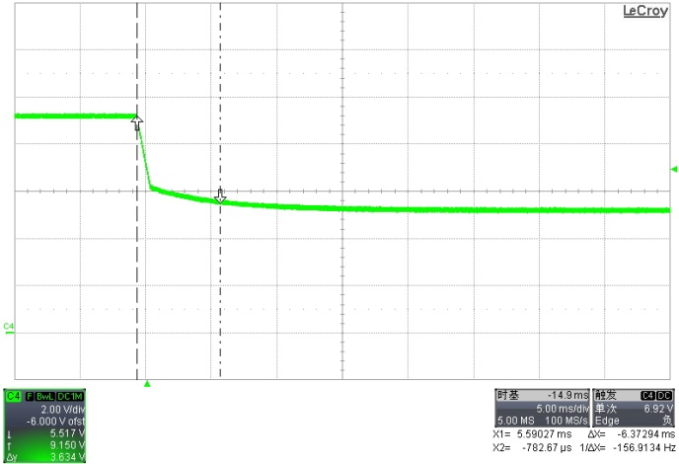
9V→5V Transition Time
9V→5V @ 85V, 0A | 9→5V @ 265 V, 0A
9V-->5V @ 85Vac, 2.0A | 9→5V @ 265Vac, 2.0A
85V
Vac(V) | 85 |  | 265
Iout(A) | 0 | 2.0 | 0 | 2.0
Transition time (mS) | 35.5 | 6.48 | 34.61 | 6.37

Slide 22
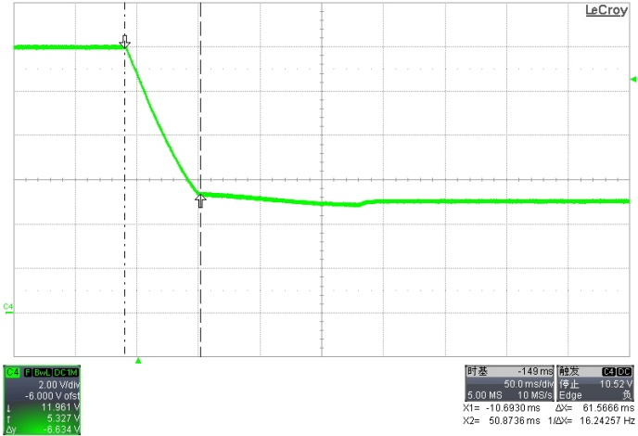
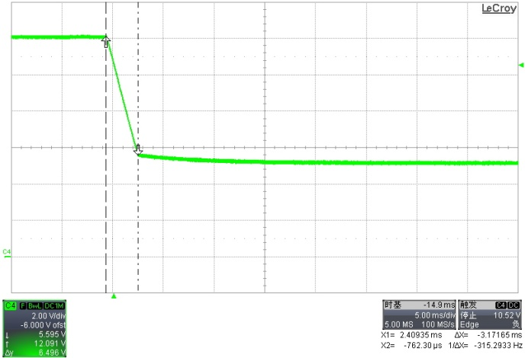
12V→5V Transition Time
12V→5V @ 85V, 0A | 12→5V @ 265 V, 0A
12V-->5V @ 85Vac, 1.5A | 12→5V @ 265Vac, 1.5A
85V
Vac(V) | 85 |  | 265
Iout(A) | 0 | 1.5 | 0 | 1.5
Transition time (mS) | 61.56 | 3.17 | 57.81 | 3.03

Slide 23
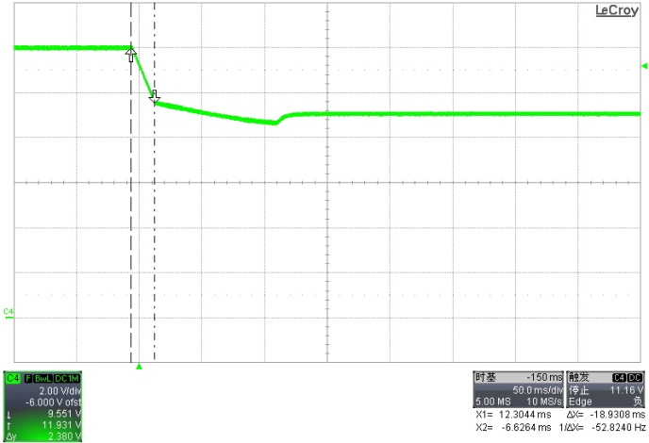
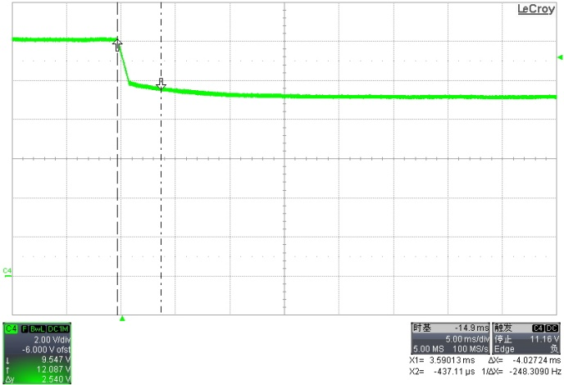
12V→9V Transition Time
12V→9V @ 85V, 0A | 12→9V @ 265 V, 0A
12V-->9V @ 85Vac, 1.5A | 12→9V @ 265Vac, 1.5A
85V
Vac(V) | 85 |  | 265
Iout(A) | 0 | 1.5 | 0 | 1.5
Transition time (mS) | 18.89 | 4.02 | 18.2 | 3.97

Slide 24
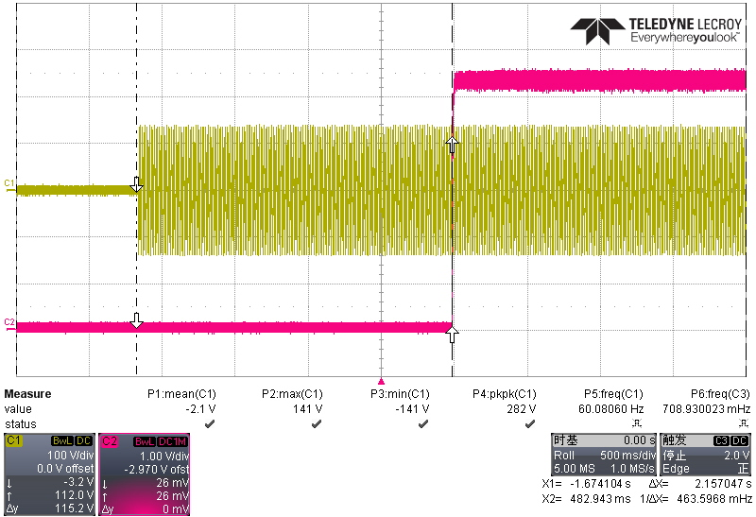
Start time
Test condition: Vo=5V Io=3A Vin=85V 60Hz
Vin
Vout
Start time=2.16S

Slide 25
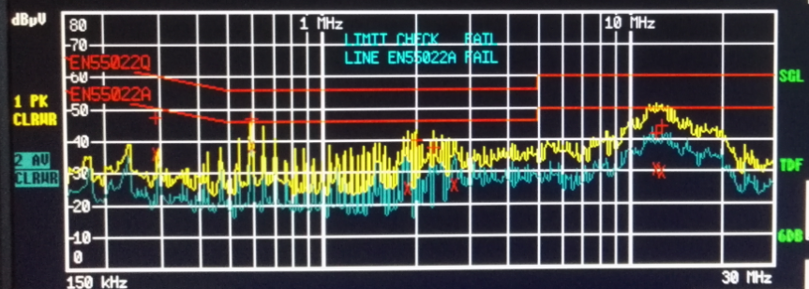
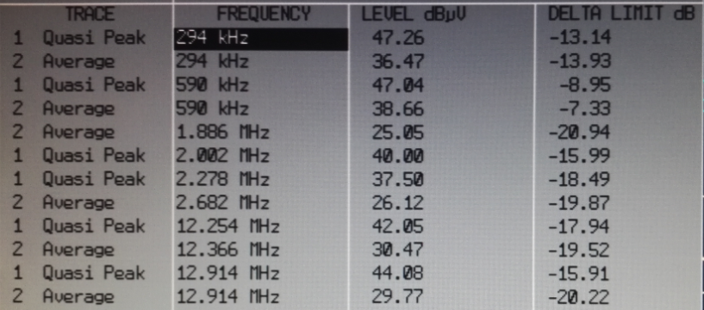
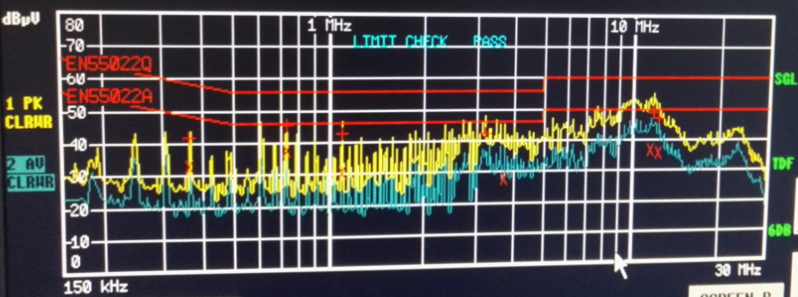
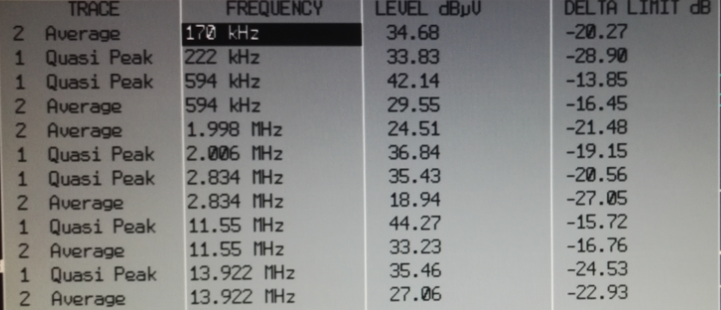
EMI(150K~30MHz)
Test condition: Vo=12V Io=1.5A Vin=230V 50Hz

Slide 26
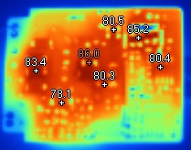
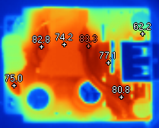
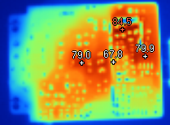
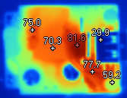
Thermal
Vin=90V
Vo=6V Io=3A
Vin=264V
Vo=6V Io=3A

