Slide 1
Great Power Microelectronics Corp.
CMC 60W LED驱动电源方案
2014.07.21

Slide 2
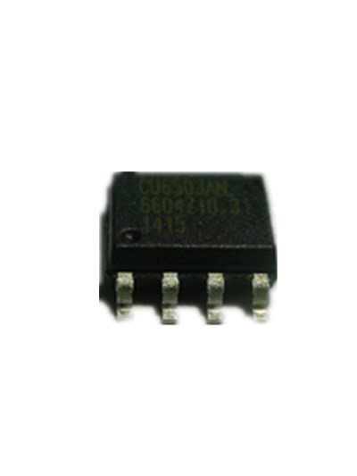
CMC 60W LED驱动电源方案
CU6503AN 60W应用方案概述
CU6503AN 60W Demo 相关参数资料
CU6503AN 60W 应用方案优势比对
CU6503AN 应用总结
总结

Slide 3
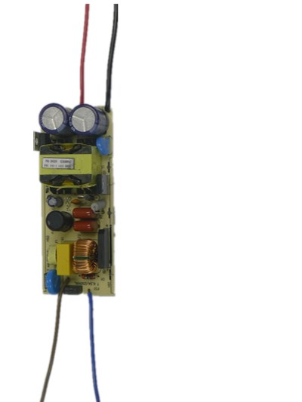
60W 应用方案概述
Ipk<1.4 倍DC电流输出
变压器/MOS应力小
EMI容易通过
电源设计简单
PFC、THD无须环路调节
CCM模式
效率：92%
PFC：0.95
THD：10
BOM：20RMB

Slide 4
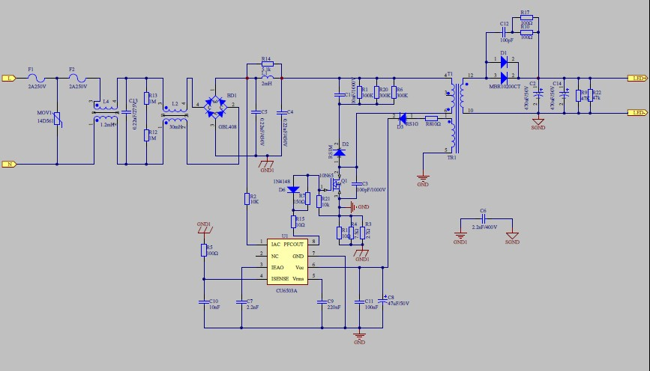
60W Demo 相关参数资料
60W 应用方案原理图

Slide 5
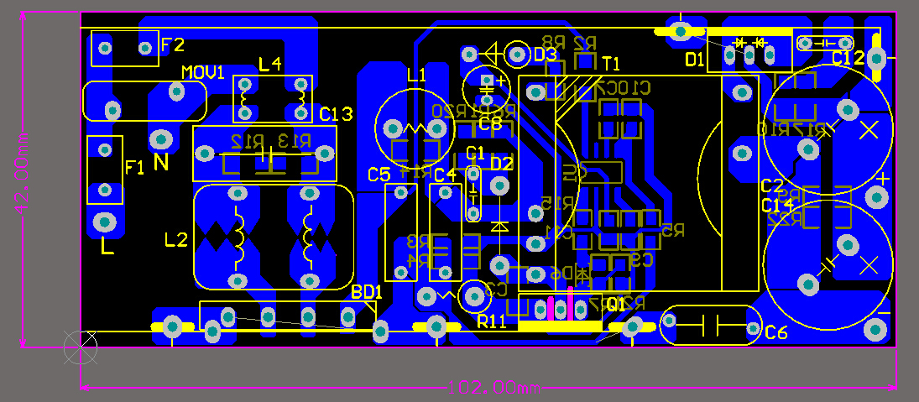
60W Demo 相关参数资料

Slide 6
Test Report
40V1.5A POWER TEST DATA
Vin(Vac) | Pin(W) | PF | Vout(Vdc) | Iout(A) | Eff(%) | THD
110 | 67.420 | 0.9931 | 40 | 1.494 | 88.64% | 5.16
115 | 67.690 | 0.9925 | 40 | 1.502 | 88.76%
230 | 65.590 | 0.9428 | 40 | 1.484 | 90.50%
264 | 64.910 | 0.9099 | 40 | 1.469 | 90.53% | 14.25
Average | 66.154 |  |  | 1.487 | 89.60%
Accuracy | 1.50% | Line regulation |  | 2.43%

Slide 7
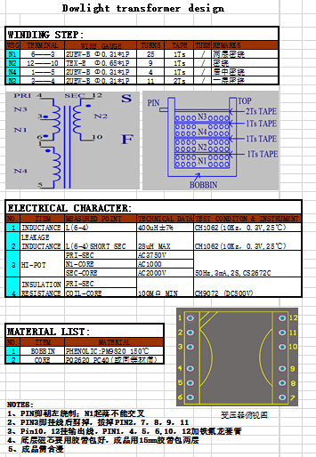
Transformer Design
7

Slide 8
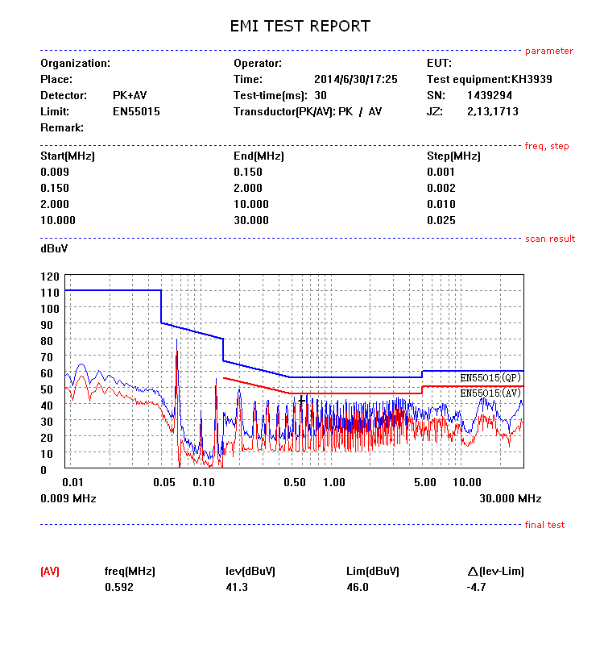
60W Demo 相关参数资料

Slide 9
CU6503AN功能
Built-in HV Start Up
Fast start-up (<0.3S)
Single stage PFC + PWM
Universal input without HV E-cap (longer life, lower cost)
High PF (>0.95) & Low THD (<10%) to meet regulatory
CCM Mode with
Internal Soft-Start
Lower peak current & Smaller Transformer (Lower Cost)
Can use lower current rating MOSFET(Lower Cost)
Less EMI suppression needed (Lower cost)
CC+CP
No need LED Vf & IV binning
Minimize impact of Vf change
Precision PSR (+/-2.5%)
No need opto-coupler
UVP & OVP Short & Open Protection
No need MOV or only lower rating MOV required
Reliable
Fixed Frequency
Simple magnetic design
Minimum EMI suppression
Minimum external component
Lower material and assembly cost

Slide 10
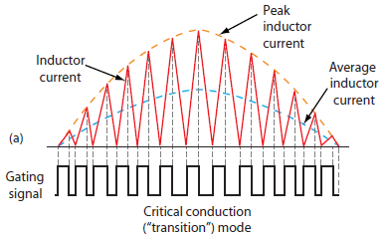
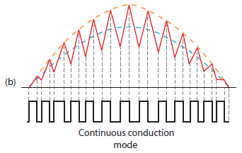
CU6503AN CCM解读
Lesser component
Lower peak current
Lower Current MOS
Cost down
Smaller transformer
Better EMI

Slide 11
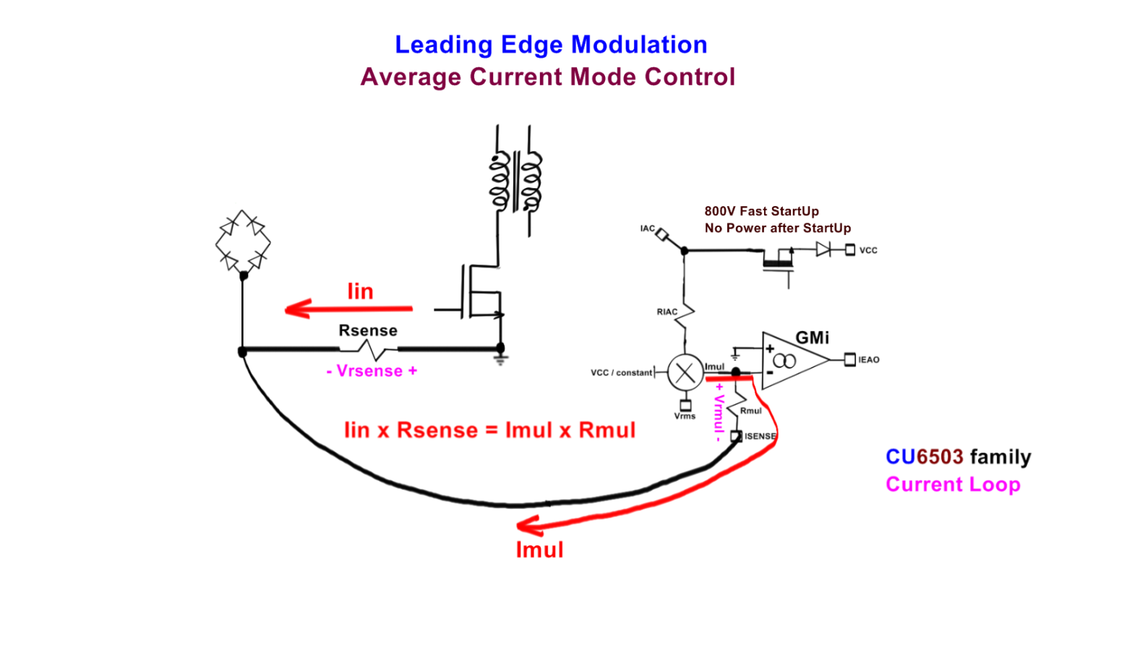
CU6503AN内部设计原理
Pin = Vin x Iin
Pin = Vin x Imul x Constant
Pin = Vin x Constant x Iac x Vcc / (constant x Vrms x Vrms)
Pin = Vin x Vin x Vcc x Constant / (Vin x Vin)
Pin = Constant for Constant Power (CP) LED
or
Pin = Vcc x Constant for CP + Constant Current (CC) LED
Pin = LED x Constant for CC LED

Slide 12
60W 应用方案优势比对
CU6503AN SY5800比对
A
同款变压器比较：
PQ2620
A：CU6503AN
B：SY5800
B
A 60W
A 2PCS共模
A MOS 10A 650V
A 变压器没有屏蔽
B 45W
B 3PCS共模
B MOS 12A 650V
B 变压器有屏蔽

Slide 13
CU6503AN 应用总结
PQ2620变压器
10A650V MOSFET
EMI只需2PCS共模
过浪涌3000V
过雷击6000V

Slide 14
CMC 设计理念
BOM COST
SIMPLE
DIFFERENT
RELIABLE
FUTURE

Slide 15
谢谢！

