Slide 1
FL7733 EVT1 System Verification Report
Oct.29.2013
Power Conversion Korea
Inki-Park

Slide 2
Schematics[8.4W]

Slide 3
Transformer[8.4W]
Transformer Core : RM6
Inductance of Primary side : 1mH
No | Winding | Pin(S → F) | Wire | Turns | Winding Method
1 | N_{P1} | 6 →1 | 0.20φ | 54Ts | Solenoid winding
2 | Insulation : Polyester Tape t = 0.025mm, 2Layers
3 | N_{S} | NS + → NS- | 0.25φ (TIW) | 30Ts | Solenoid winding
4 | Insulation : Polyester Tape t = 0.025mm, 2Layers
5 | N_{A} | 5→ 3 | 0.16φ | 20Ts | Solenoid winding
6 | Insulation : Polyester Tape t = 0.025mm, 2Layers
7 | N_{P2} | 1 → 2 | 0.20φ | 27Ts | Solenoid winding
8 | Insulation : Polyester Tape t = 0.025mm, 6Layers

Slide 4
1. Protection
1) SCP
2) SRSP
3) SROP
4) ODSP
5) VS OVP

Slide 5
SCP
Concept
VS voltage at gate-off is close to zero when LED load is shorted.
SCP is disabled for the initial 14 ms once V_{DD} is higher than UVLO.
200ms JFET regulation enlarges AR time during SCP.

Slide 6
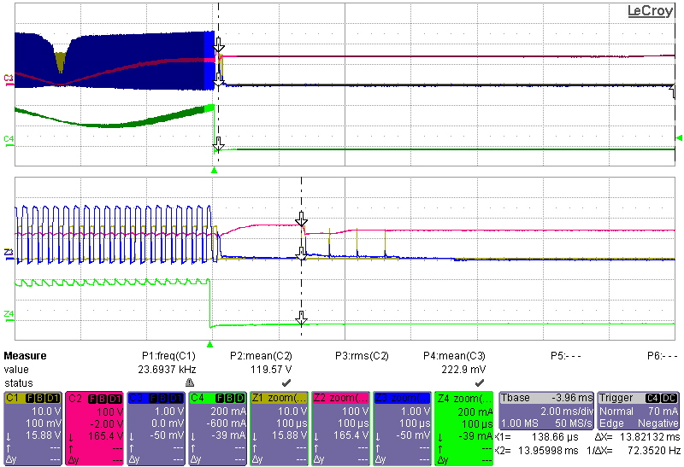
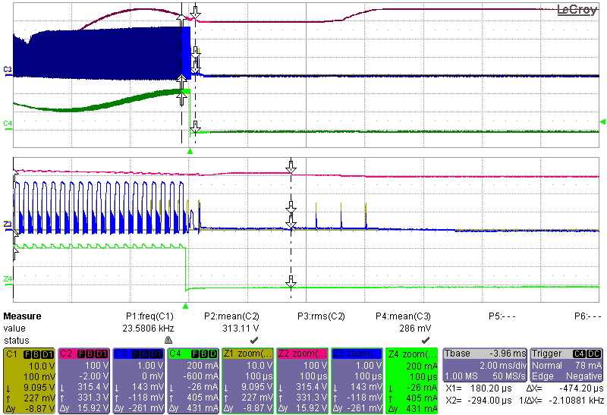
SCP
Test Results
Test condition: C_{COMI}[2.2uF], C_{VDD}[10uF].
Vin[90Vac]
Vin[265Vac]
Ch1[V_{GATE}],,Ch2[V_{IN}], Ch3[V_{VS}], Ch4[I_{OUT}]
SCP de-bounce cycle is 4 and operated well.

Slide 7
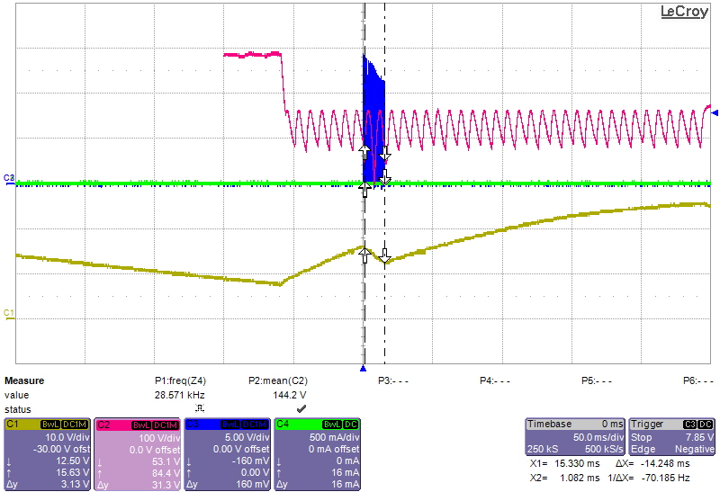
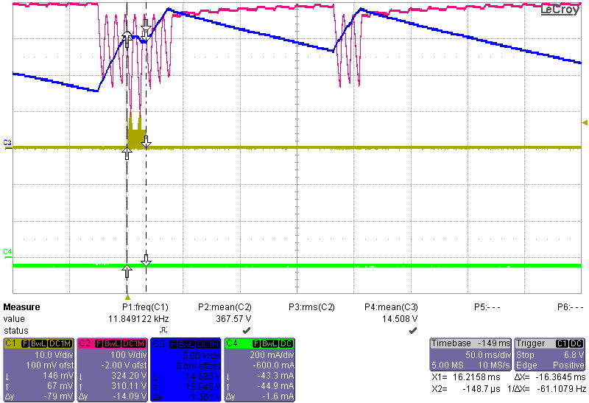
SCP
Test Results
Test condition: , Rstr[30k], C_{COMI}[1.0uF], C_{VDD}[10uF].
EVT0
EVT1
T_{SCP.bnk}:14ms -->OK
V_{JFET.HL} : 19V
T_{SCP.bnk}:16ms
V_{JFET.LL} : 13V
Ch1[V_{DD}],,Ch2[V_{IN}], Ch3[V_{GATE}], Ch4[I_{OUT}]
Ch1[V_{GATE}],,Ch2[V_{IN}], Ch3[V_{DD}], Ch4[I_{OUT}]
T_{SCP.bnk} of EVT1 was larger than EVT0.
JFET regulation is operated well.

Slide 8
Current-mode SRSP
Concept
Current-mode SRSP protects the condition that sensing resistor is short before VDD-ON.
Vin level is be detected by Ivs and T_{VCS-BNK} is inversely proportional to Vin level.
Once V_{CS} is maintained under 0.1V for T_{VCS-BNK}, SRSP is triggered.
Current-mode SRSP is monitored only for first switching cycle.

Slide 9
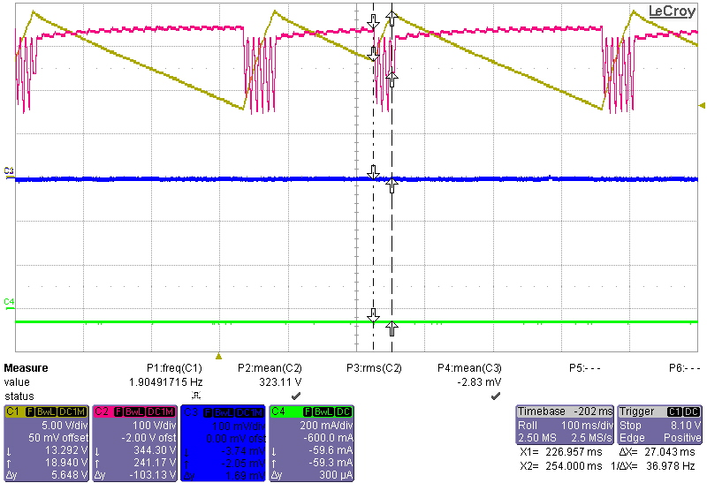
Current-mode SRSP
Test Results
Test condition: C_{COMI}[2.2uF], C_{VDD}[10uF].
Vin[265Vac]
Vin[90Vac]
Ton_{SRSP}: 4.2us
V_{JFET.HL} : 19V
V_{JFET.LL} : 13V
Vin[265Vac]
Ton_{SRSP}: 1.9us
Ch1[V_{DD}],,Ch2[V_{IN}], Ch3[V_{CS}], Ch4[I_{OUT}]
SRSP is operated well.
JFET regulation is operated well.

Slide 10
Voltage-mode SRSP
Concept
Voltage-mode SRSP protects the condition that sensing resistor is short after VDD-ON.
SRSP monitoring is enabled when Vin is higher than 60% of peak Vin.
Once V_{CS} is maintained under 0.1V for SRSP monitoring time, SRSP is triggered.

Slide 11
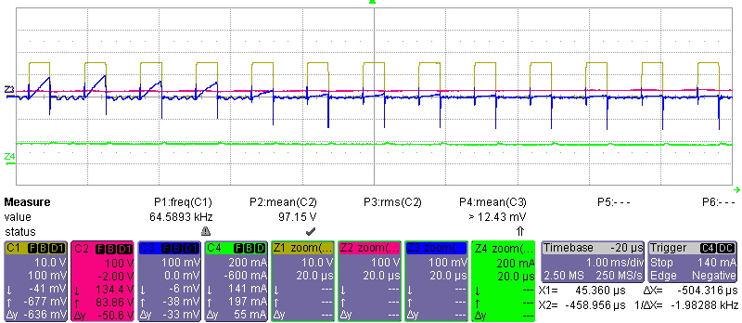
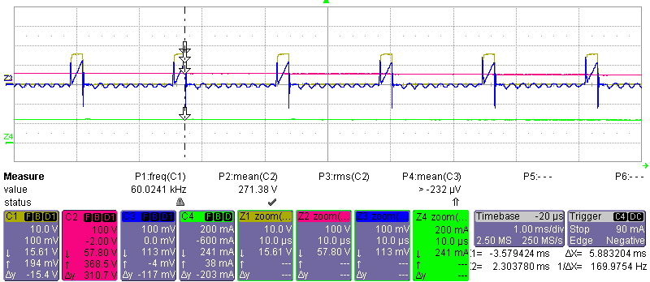
Voltage-mode SRSP
Test Results
Test condition: C_{COMI}[2.2uF], C_{VDD}[10uF].
Vin[90Vac]
Vin[265Vac]
a
b
A
B
Rcs Short
SRSP Trigger
SRSP Trigger
Rcs Short
a
A
Vin: a<b
Vcs: a>b
Vcs < 0.1V
Vcs < 0.1V
Vin: a<b
Vcs: a>b
b
B
Vin: 83V[≈130V *0.6]
Vin: 248V[≈368V *0.6]
Ch1[V_{DD}],,Ch2[V_{GATE}], Ch3[V_{CS}], Ch4[I_{OUT}]
Voltage mode SRSP is operated well

Slide 12
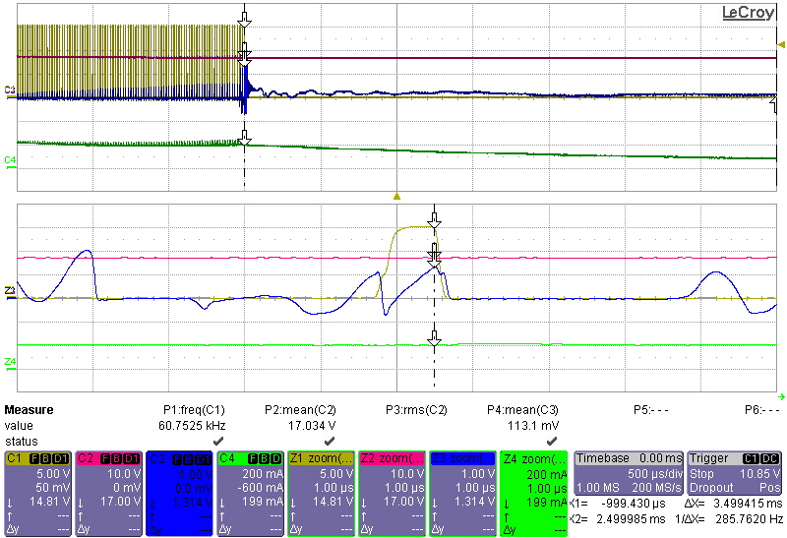
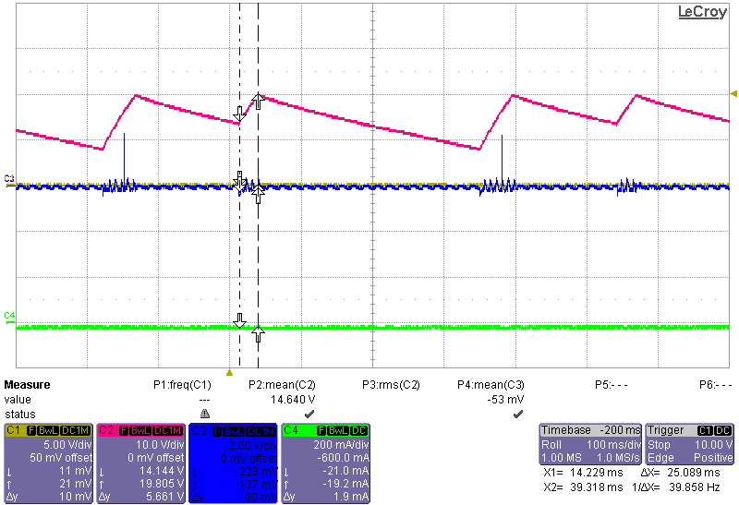
SROP
Test Results
Test condition: C_{COMI}[2.2uF], C_{VDD}[10uF].
1.0us/div
100ms/div
Ch1[V_{GATE}],,Ch2[V_{DD}], Ch3[V_{CS}], Ch4[I_{OUT}]
SROP is operated well.
JFET regulation is operated well.

Slide 13
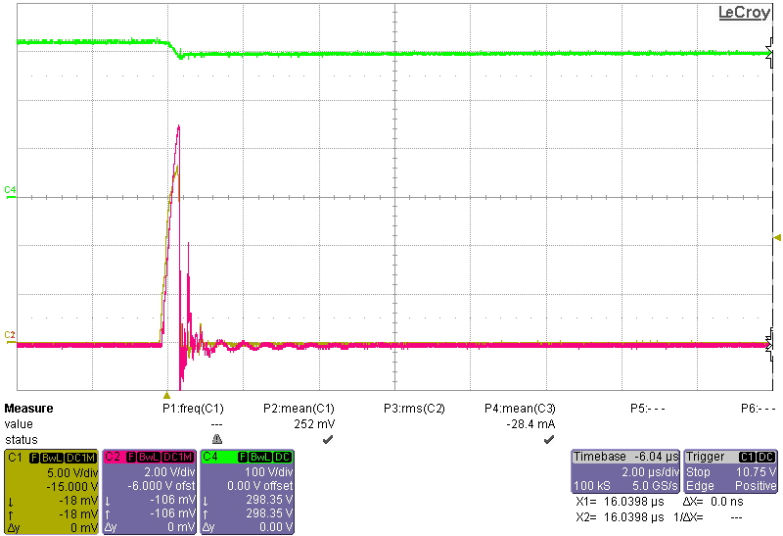
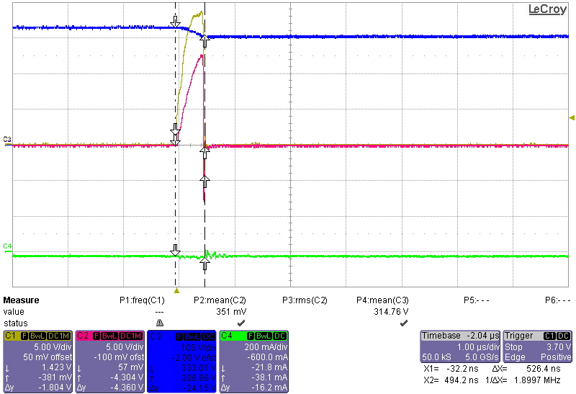
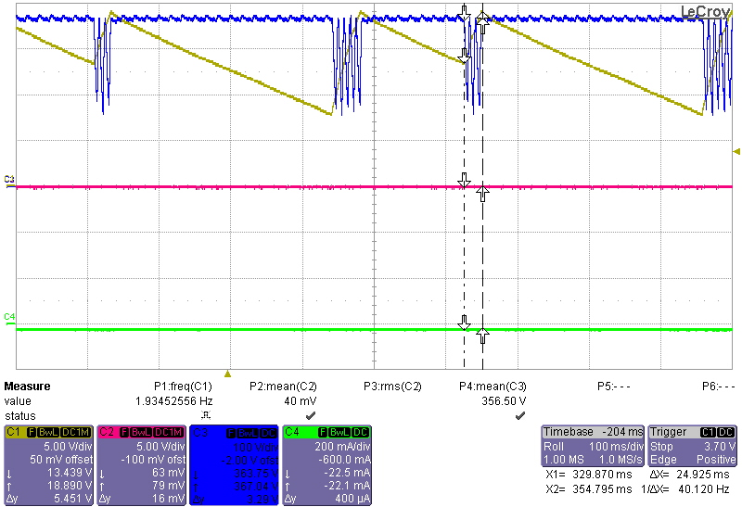
OCP[ODSP]
Test Results
Test condition: Vin[265Vac], C_{COMI}[2.2uF], C_{VDD}[10uF]. Csn[20nF], Rsn[100k]
1.0us/div
100ms/div
V_{JFET.HL} : 19V
V_{JFET.LL} : 13V
Ch1[V_{GATE}],,Ch2[V_{CS}], Ch3[V_{IN}], Ch4[I_{OUT}]
OCP is triggered with just one pulse.
JFET regulation is operated well.

Slide 14
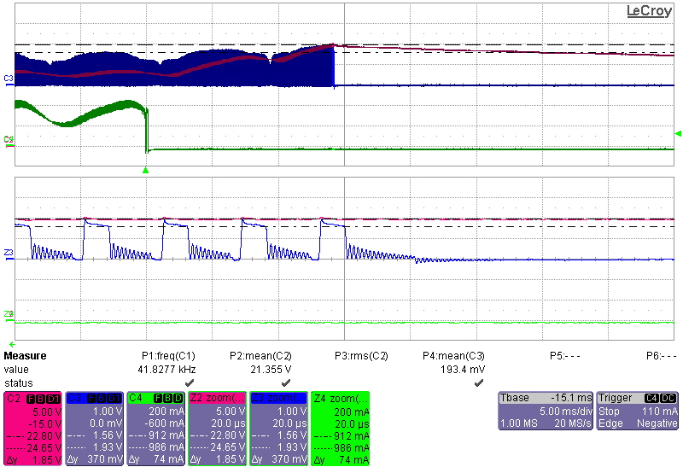
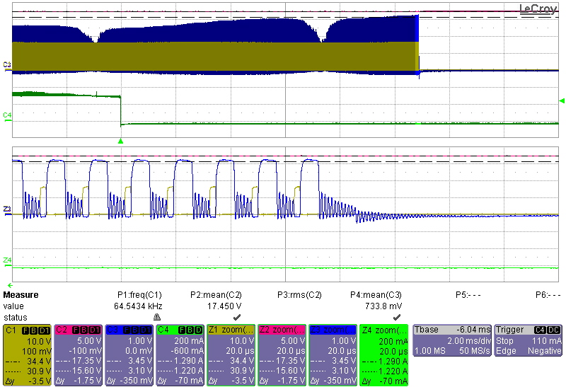
OVP – VDD and VS
Test Results
Test condition: C_{COMI}[2.2uF], C_{VDD}[10uF].
VDD OVP
VS OVP
LED Open
LED Open
V_{DD}: 17.3V
V_{DD}: 24.8V
V_{VS}: 3.1V
V_{VS}: 1.56V
Ch1[V_{GATE}],,Ch2[V_{DD}], Ch3[V_{VS}], Ch4[I_{OUT}]
After LED opened, VDD OVP is triggered at 24.8V.
VS OVP is also triggered at 3.1V after LED opened.

Slide 15
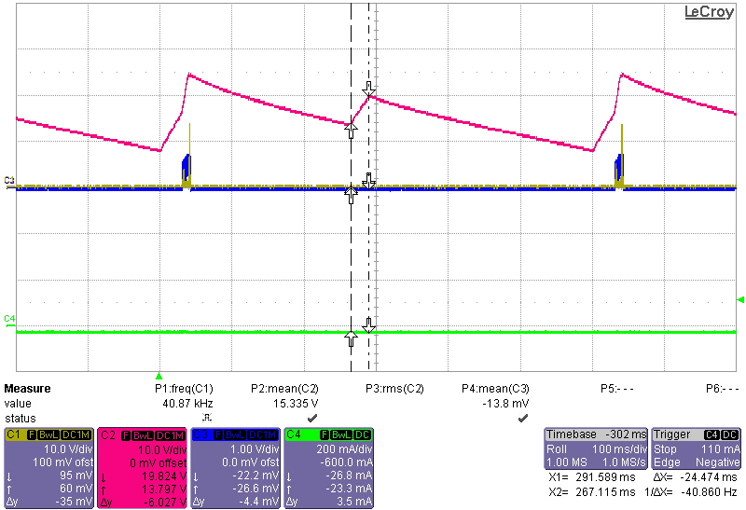
OVP – VDD and VS
Test Results
Test condition: C_{COMI}[2.2uF], C_{VDD}[10uF].
V_{JFET.HL} : 19V
V_{JFET.LL} : 13V
Ch1[V_{GATE}],,Ch2[V_{DD}], Ch3[V_{VS}], Ch4[I_{OUT}]
JFET regulation is operated well.

Slide 16
2. System
1) CC
2) THD/PF
3) Overshoot
4) Startup

Slide 17
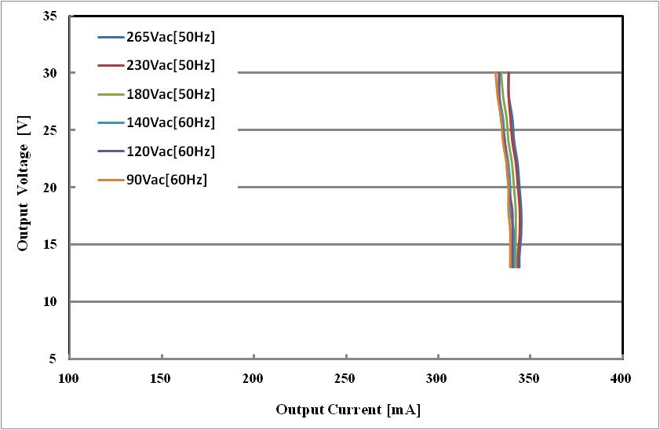
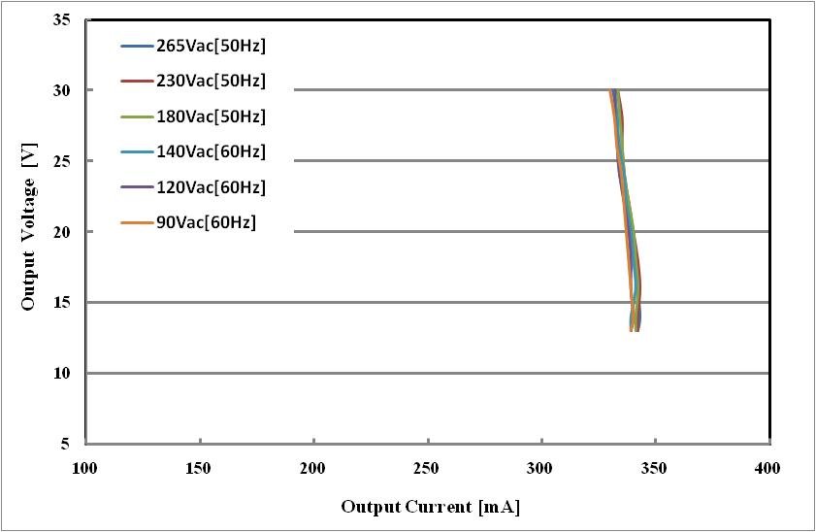
CC
Test results
Test condition: R_{VS1}[200k], R_{VS2}[30k], C_{OUT}[470uF], C_{COMI}[2.2uF]
Rcomp[200Ω]
Rcomp[220Ω]
±1.05%
±0.59%
 | 265Vac[50Hz] | 230Vac[50Hz] | 180Vac[50Hz] | 140Vac[60Hz] | 120Vac[60Hz] | 90Vac[60Hz]
Rcomp[200Ω] | ±1.02% | ±0.88% | ±1.18% | ±1.19% | ±1.04% | ±1.19%
Rcomp[220Ω] | ±1.78% | ±1.48% | ±1.33% | ±1.34% | ±1.19% | ±1.49%

Slide 18
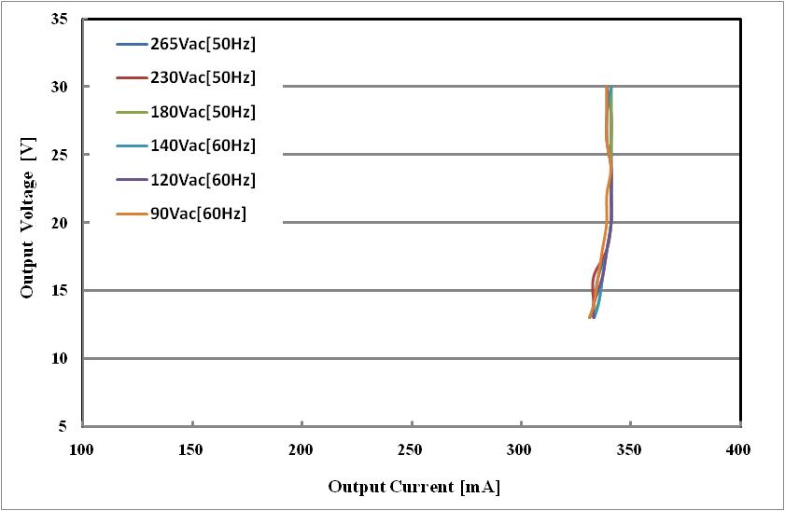
CC
Test results
Test condition: R_{VS1}[200k], R_{VS2}[30k], C_{OUT}[470uF], C_{COMI}[2.2uF]
EVT0
EVT1
±0.6%
±0.59%
Load regulation of EVT1 is having different pattern a little from EVT0.

Slide 19
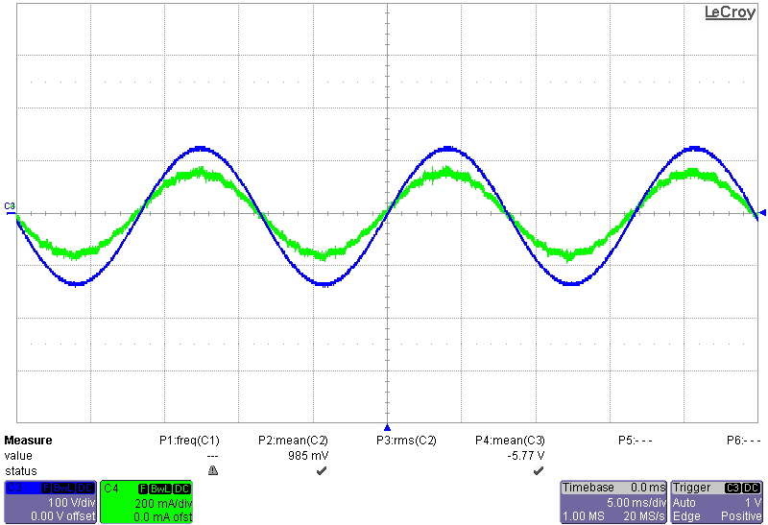
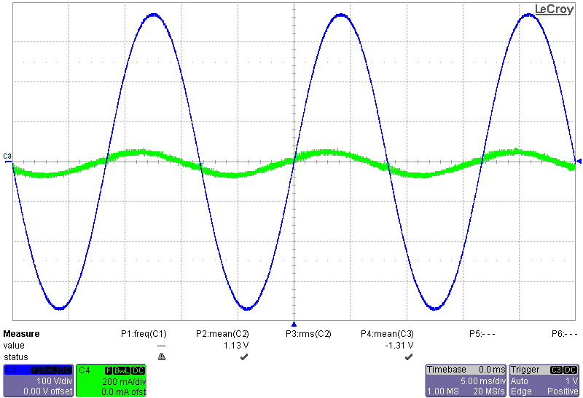
THD and PF
Test results
Test condition: C_{COMI}[2.2uF]
Vin[90Vac]
Vin[265Vac]
Ch3[V_{IN}], Ch4[I_{IN}]
Samples | Io [mA] |  | PF |  | THD[%]
 | 90Vac | 265Vac | 90Vac | 265Vac | 90Vac | 265Vac
#01 | 336 | 339 | 0.997 | 0.904 | 3.65 | 7.73
#02 | 334 | 335 | 0.997 | 0.901 | 3.53 | 7.96

Slide 20
Overshoot
Concept
Vin level is detected by Ivs and V_{COMI} is charged by V_{COMI} modulator output.
V_{COMI} modulator output is inversely proportional to Vin level.
Therefore, V_{COMI} is adjusted close to steady state level during softstart time.

Slide 21
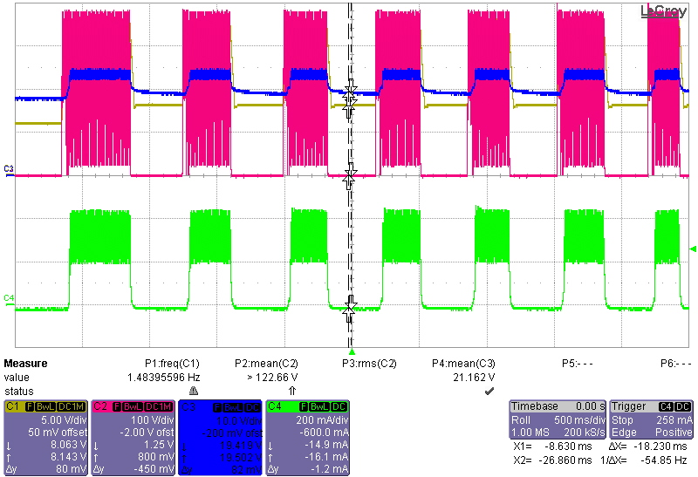
Overshoot – 8.4W
Test Results
Test condition: C_{COMI}[2.2uF], C_{VDD}[10uF], C_{VDD}[470uF], Lm[1mH].
Vin[90Vac]
Vin[277Vac]
V_{COMI_INT.CLP}: 2.1V
V_{COMI_INT.CLP}: 1.1V
Vin[265Vac]
V_{COMI_INT.CLP}: 1.5V
Ch1[V_{DD}],, Ch2[V_{IN}], Ch3[V_{COMI}], Ch4[I_{OUT}]
VCOMI clamped at startup is inverse proportional to Vin level and operated well.
→ There are no overshoot even fast On & OFF of AC power.

Slide 22
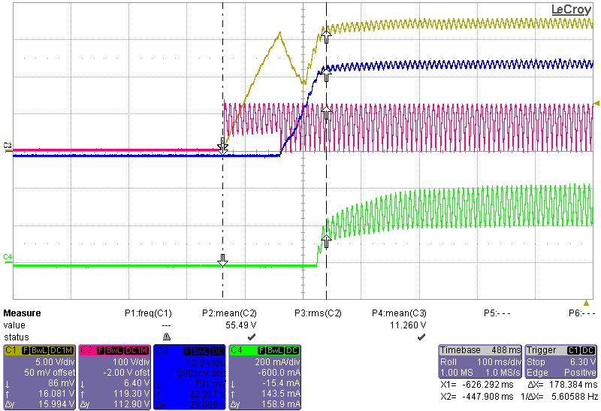
Startup time
Test Results
Test condition: Vin[90Vac], C_{OUT}[470uF], C_{COMI}[2.2uF], Lm[1mH]
Rstr: 30kΩ
178ms
Ch1[V_{DD}],, Ch2[V_{IN}], Ch3[V_{OUT}], Ch4[I_{OUT}]
Startup time can meet 0.2s.

Slide 23
Follow us on Twitter @ twitter.com/fairchildSemi
View product and company videos, listen to podcasts and comment on our blog @ www.fairchildsemi.com/engineeringconnections
Visit us on Facebook @ www.facebook.com/FairchildSemiconductor

